Slide 1
FHIR for Developers
Updated for FHIR 0.8!
Ewout Kramer
May 5, 2013

Slide 2
Introduction
Notes:
Time start-10:00 (10 minutes)

Slide 3
Introduce ourselves
About your organization…
HL7 (v2/v3) background?
Experience with FHIR?
Platform of choice (.NET, Java, Ruby, …)?
Familiar with HTTP, Xml, JSON, REST?
Persistence technologies used?
Expectations for today

Slide 4
What perspective?
v3
App
v2
FHIR
PHR
FHIR
Broker
Comm.
Interface
FHIR
DB
Notes:
You’re a message broker routing and translating between v2, v3 and FHIR
Your app interfaces with a PHR using FHIR natively
Your application can communicate using FHIR, but your software uses a proprietary RDBMS
Use FHIR as the common language for a Vendor Neutral Archive
…Or a combination….
You might see data as a nested structure of XML, a series of tables with keys, class-diagrams….

Slide 5
Contents of this tutorial
Deconstructing FHIR
FHIR RESTful service interface
Beyond REST
Searching
FHIR on the Wire
Distribution for developers
Building a FHIR server

Slide 6
Deconstructing FHIR
Looking at FHIR data modeling concepts from a software engineering perspective
Notes:
Time: 10:00-40:00 (30 minutes)

Slide 7


Resources (review!)
“Resources” are:
Small logically discrete units of exchange
Defined behaviour and meaning
Known identity / location
Smallest unit of transaction
“of interest” to healthcare
V2: Sort of like Segments
V3: Sort of like CMETs

Slide 8
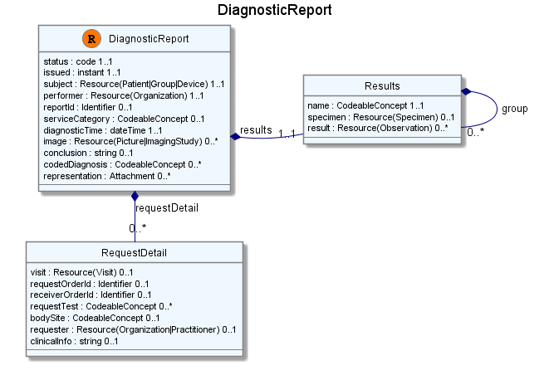
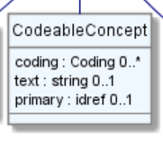
Composition of a Resource
Notes:
Depending on your background (OO, xml, database) you have a different perspective on:
Cardinality of elements - “collections” or “repeating items” or “1-many relationships”
The notion of composition – “nested class”, “what’s special?”, “1-many relationships”
References “what’s special?”, “Xml:id? Repeated data?”, “1-many relationships”
Choice attributes
Use of non-primitive “datatypes” / “value types”

Slide 9
Composition versus reference
FHIR makes composition and references explicit:
References are in between Resources. No context across references – safe retrieval as individual resources.
Composition is within a Resource: Components have no meaning outside resource, no identity, no separate access path except through resource
Notes:
This makes the job of the developer easier….but the job of the modeler harder: no only is the model a reflection of the concepts in healthcare, but also which combination of those concepts are the predefined, reusable blocks?

Slide 10
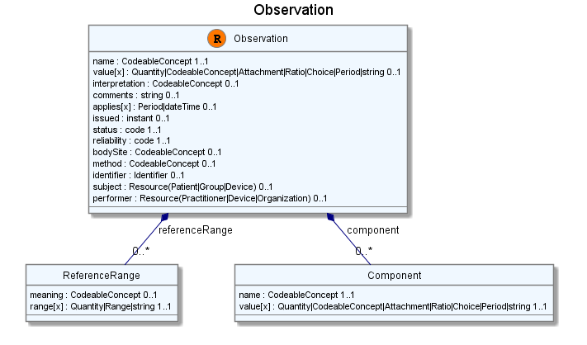
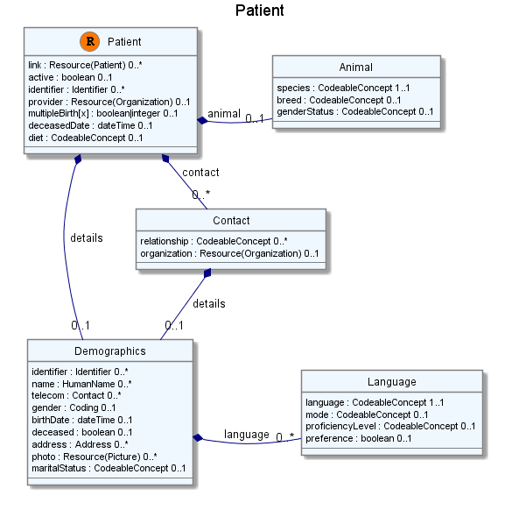
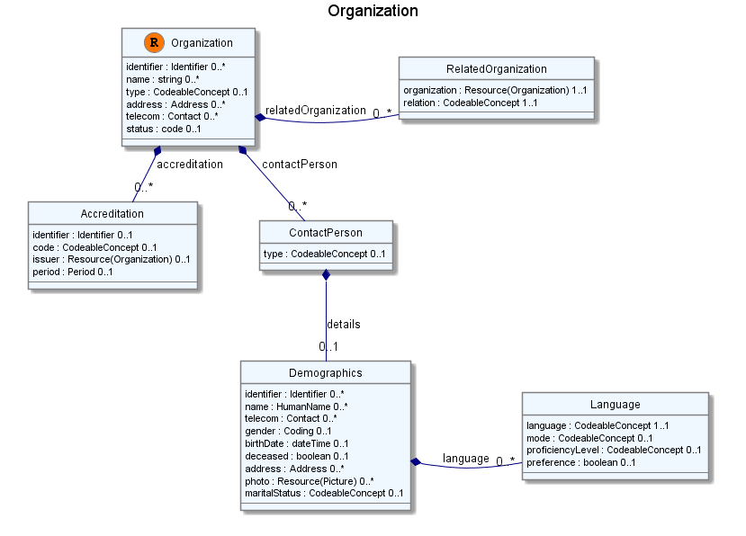
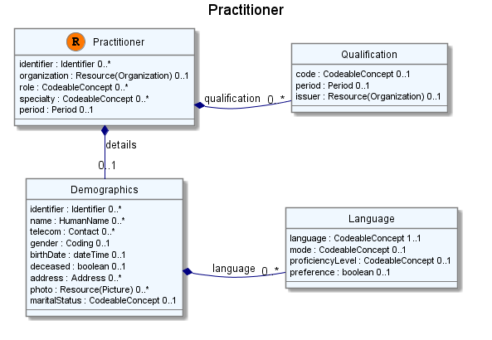
Network
subject
performer
organization

Slide 11
Not a hierarchy!
Patient
Episode
Episode
Visit
Visit
Observation
Order

Slide 12
A Resource’s identity
In fact: an URL
http://server.org/fhir/patient/@1
resource type
endpoint
identifier
Note: This URL resolves to the current version of a resource
Notes:
This is not only the URL you use to retrieve the resource, it’s also its id.
All URL’s in FHIR are case-sensitive (and so is the id)

Slide 13

Resource Aggregate
“How do we know where an object
made up of other objects begins
and ends?”
“In any system with persistent storage
of data, there must be a scope for a
transaction that changes data and a way of maintaining the consistency of the data”
Notes:
Very important concept, comparable with the “Aggregate” notion of Domain Driven Design, for which many useful implementation strategies have been documented on the internet.

Slide 14
The FHIR Elements
Composite
Datatypes (HumanName, Quantity, Period, Address, Identifier )
Constrained Types (Quantity: Distance, Count, Duration, Money)
use
Primitives (integer, boolean,
string, instant)
Derived Primitives
(oid, uuid, code, id)
Notes:
Only the Resources are user-definable, other types are “built-in”
Derived primitives are patterns -> validation consists of regexp matching
Constrained types are defined using invariants (OCL, Xpath, prose) -> validation using schematron, code
Narrative and Extension are both ONLY used in Resources
Resources can use both (derived) primitives and composite datatypes in its definitions
Infrastructural types need special handling, not general-purpose types

Slide 15
Start at the bottom: Primitives
boolean | xs:boolean | Values can be either true or false
integer | xs:int | A signed 32-bit integer
decimal | xs:decimal | A rational number. A true decimal, with inbuilt precision (e.g. Java BigDecimal)
base64Binary | xs:base64Binary | A stream of bytes, base64 encoded
instant | xs:dateTime | An instant in time - known at least to the second and always includes a timezone.
string | xs:string | A sequence of Unicode characters.
uri | xs:anyURI | A Uniform Resource Identifier Reference.
date | union of xs:date, xs:gYearMonth, xs:gYear | A date, or partial date as used in human communication. No time zone.
dateTime | union of xs:dateTime, xs:date, xs:gYearMonth, xs:gYear | A date, date-time or partial date as used in human communication. If hours and minutes are specified, a time zone must be populated.
Notes:
The lexical rendering for these primitives in Xml is the same as in JSON (maybe this should go in the serialization section)
Expressing the allowed values in terms of XSD primitives brings in more variability then we would like. E.g. “0” and “1” are valid for xs:boolean. “+000004”, “4”, “+4” are all valid decimals.

Slide 16
Derived primitives
Based on uri(!): OID and UUID
urn:oid:1.2.3.4.5
urn:uuid:a5afddf4-e880-459b-876e-e4591b0acc11
Based on string:
code (string of characters, may contain single spaces) - “4548-4”, “active”, “not known”
id ([a-z0-9\-\.]{1,36})
Notes:
TODO: Search on timestamps (lower, upper bound), converting to zulu, user-timezone, sorting of times etc.

Slide 17
Not that simple in practice
xs:boolean allows “0”, “1”. Java’s Boolean.valueOf() does not. But valueOf() allows “True”, which xs:boolean does not.
“+00004” is correct according to xs:int. .NET parses this, Java does not. Ruby’s to_i() allows “34abc” and the Integer() constructor sees “09” as an (incorrect) octal…
Generally not round-trippable (problems for unit-tests, digital signatures)
Notes:
Or in real practice (aka the connectathon) it turns out to be no problem!?

Slide 18
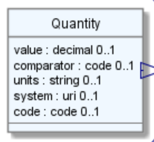
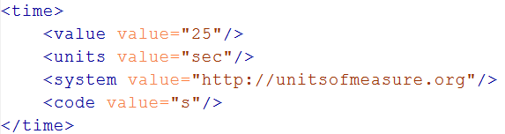
Level up: Composite Datatypes
Notes:
The content of a primitive is not rendered in XML as a text node but as an attribute
Notice how the “system” of a code is now a uri, so unlike in v3 an OID is now ALSO a uri (urn:oid:1.2.3.4.5)

Slide 19
Datatypes
Let’s take a look at the “Data Types” section of the FHIR specification at
http://www.hl7.org/implement/standards/fhir/datatypes.htm
Notes:
Datatypes use both primitives and other datatypes.
Some datatypes use attributes with cardinality > 1
CodeableConcept.primary is actually refers to a coding in CodeableConcept.coding, so is not a code itself.
Quantity has constrained variations Distance, Count, Duration, Money. They introduce constraints on useable units, but do not add attributes, so not shown here.
Note that HumanId.assigner refers to a Resource

Slide 20
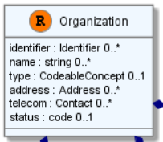
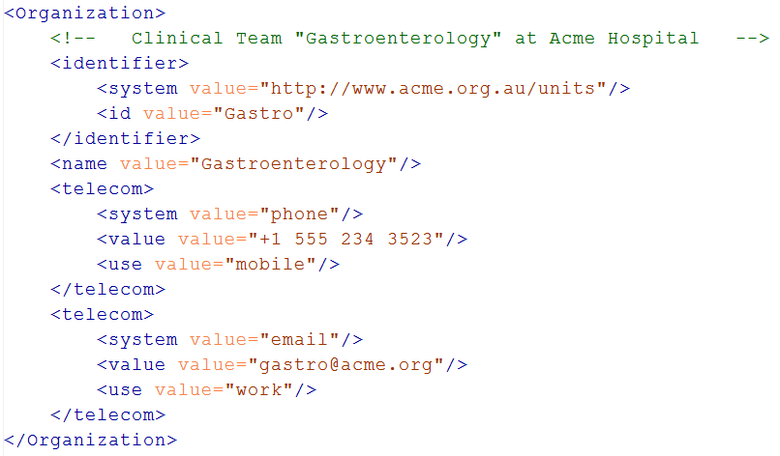
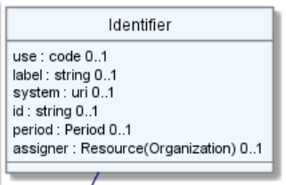
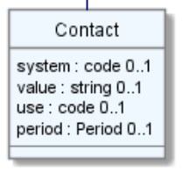
Level up: resources
Notes:
The element “identifier” is of type HumanId, which in its turn has an element “identifier” of type “Identifier”.
The element “telecom” repeats, there is no notion of a “list” in Xml.
Empty elements are left out

Slide 21
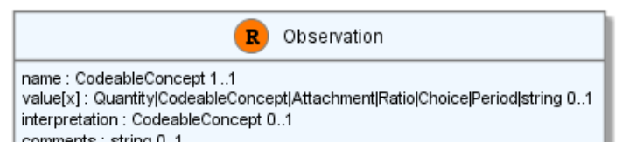
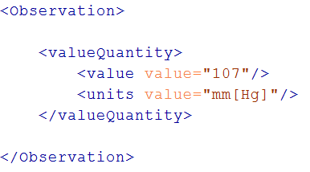
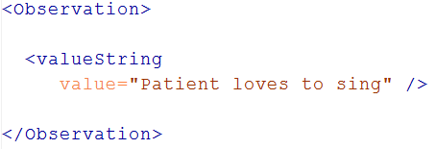
“Choice” properties
Notes:
* value[x] means: An element with a name that starts with “value”. The [x] is replaced by the (capitalized) name of the actual datatype

Slide 22
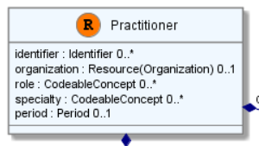
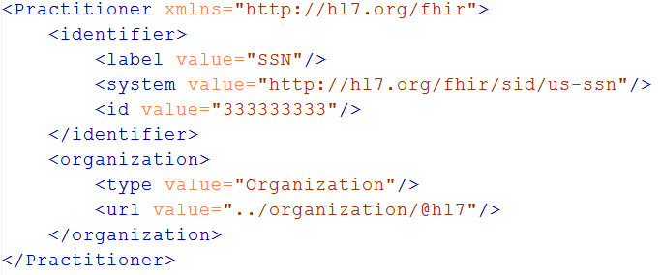
References
These uri’s may be:
Relative
Absolute URL (own server)
external reference URL
Notes:
There are references that can reference more than one type of resource! Ex. Observation.performer: Resource(Practitioner|Device|Organization)
So, if you have your resources stored in separate tables, the table you have to “join” to cannot be determined in advance, it’s per-instance!

Slide 23
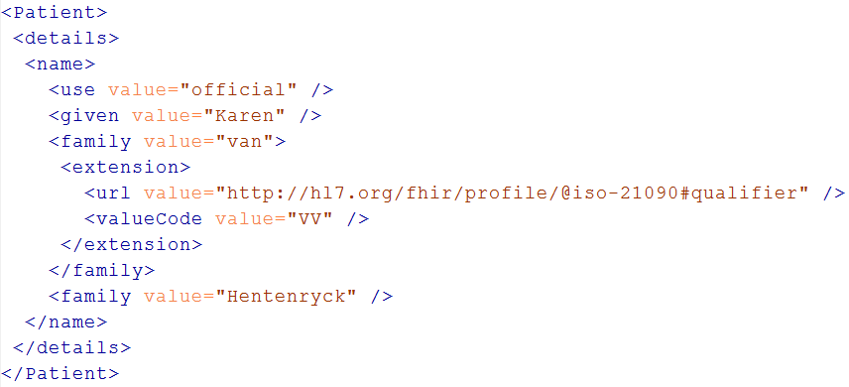
Extensions
Really any FHIR element (Resource, Datatype, Primitive) can be extended. Just nest an <extension> element under the thing you want to extend:
Just a Key/Value pair

Slide 24
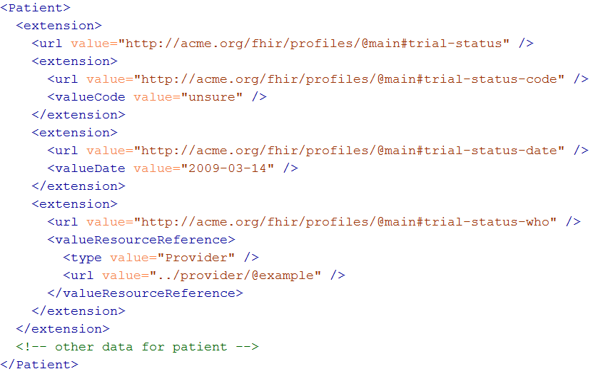
Complex extensions
Notes:
* Extensions can be nested to include more complex data.

Slide 25
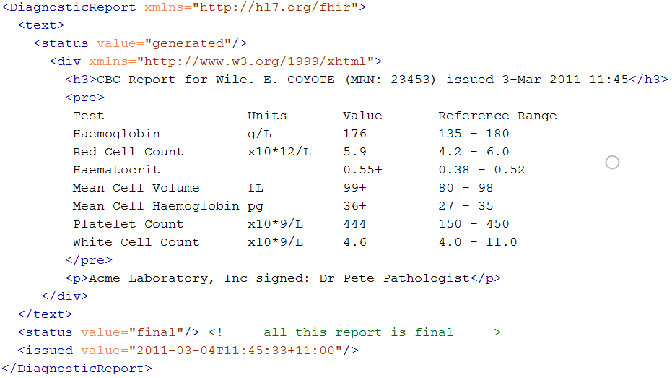
Narrative
Notes:
* “Every resource SHALL include a human readable narrative”

Slide 26
The FHIR datamodel (simplified!)
Composite
Datatypes
Constrained Types
Resources
Narrative
Resource
Reference
Elements
Extensions
Primitives
Derived Primitives
Notes:
Only the Resources are user-definable, other types are “built-in”
Derived primitives are patterns -> validation consists of regexp matching
Constrained types are defined using invariants (OCL, Xpath, prose) -> validation using schematron, code
Narrative and Extension are both ONLY used in Resources
Resources can use both (derived) primitives and composite datatypes in its definitions
Infrastructural types need special handling, not general-purpose types

Slide 27
Resources in code
How resources are made into classes in the supplied reference implementations
Notes:
Time: 40:00-50:00 (10 minutes)

Slide 28
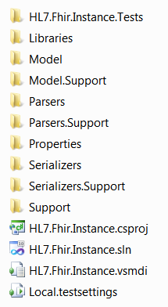
C# reference implementation
Download Csharp.zip from the Implementation page (source code distribution):
Libaries – 3rd party libraries
Model – C# classes generated from the spec
Parsers – C# Parsers generated from the spec
Serializers – C# Serializers generated from the spec
Model.Support, Parsers.Support, Serializers.Support are files with hand-written support-code
All are partial classes, you can add to them without losing code after generation
Compile to HL7.Fhir.Instance.dll

Slide 29
A FHIR Resource in C#
public partial class Observation : Resource
{
// Codes that provide reliability information about an observation
public enum ObservationReliability {Ok, Ongoing, …}
// Codes identifying interpretations of observations
public enum ObservationInterpretation {N, A, L, H }
public CodeableConcept Name { get; set; }
public List<ObservationReferenceRangeComponent> ReferenceRange { get; set;}
public Code<Observation.ObservationReliability> Reliability { get; set; }
public ResourceReference Performer { get; set; }
}
Notes:
Enums are generated for coded types with required, fixed, valuesets
Nested classes are defined for each component in a Resource, all nested directly within the Resource
Cardinality > 1 => becomes a List<>
Cardinality 1 => Not expressed in model, but done in validation
All classes are partial so you can add code them in another code file (keeping generated+handcrafted code separate)

Slide 30
Parsing using C#
ErrorList errors = new ErrorList();
// Create a file-based reader for Xml
XmlReader xr = XmlReader.Create(
new StreamReader(@"publish\observation-example.xml"));
// Create a file-based reader for Xml
var obs = (Observation)FhirParser.ParseResource(xr, errors);
// Modify some fields of the observation
obs.Status = ObservationStatus.Amended;
obs.Value = new Quantity() { Value = 40, Units = "g" };
// Serialize the in-memory observation to Json
var jsonText = FhirSerializer.SerializeResourceAsJson();

Slide 31
Parsing using Java
import org.hl7.fhir.instance.formats.XmlComposer;
import org.hl7.fhir.instance.formats.XmlParser;
import org.hl7.fhir.instance.model.Resource;
XmlParser xml = new XmlParser();
xml.setAllowUnknownContent(false);
LabReport resource = (LabReport)xml.parse(
new FileInputStream("publish\\labreport-example.xml"));
TODO: Grahame, how to Parse JSON?

Slide 32
Serializing using Java
LabReport resource = ……;
FileOutputStream out = new FileOutputStream("labreport.js");
JsonComposer jsonc = new JsonComposer();
jsonc.compose(out, resource);
// FileOutputStream out = new FileOutputStream("labreport.xml");
// XmlComposer xmlc = new XmlComposer();
// xmlc.compose(out, resource, true);
Notes:
* Argument “true” on compose() is the “pretty” y/n boolean.

Slide 33
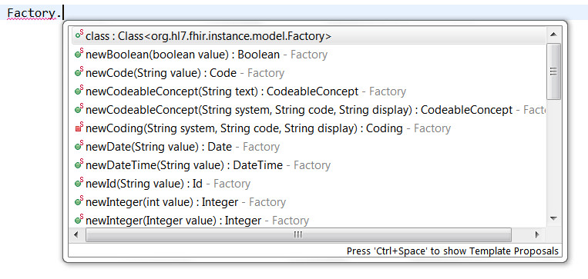
Creating Java Resources
Factory.java has multiple static methods to construct:

Slide 34
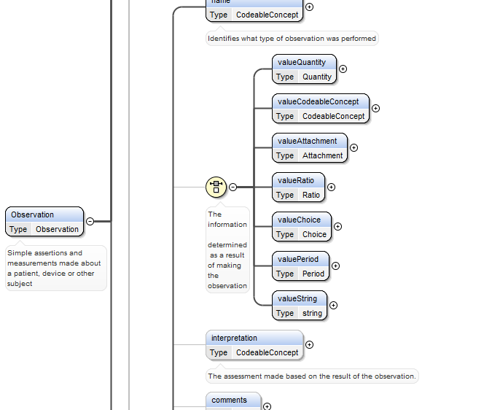
Java, C#, Delphi, Xsd
Notes:
Just like in C#, coded types with fixed valuesets are represented as an enumeration
All cardinalities are converted to equivalent min/maxOccurs on elements
Nested components get their own ComplexType’s
Polymorhpic elements result in multiple elements in a Choice.

Slide 35
REST service interface
How FHIR uses RESTful principles to communicate Resources
Notes:
Time: 0:50:00-1:30:00 (40 minutes)

Slide 36
REST?
“REpresentational State Transfer”
Represent your data as “resources”
Make “Resources” URI addressable
Use HTTP to do CRUD operations
Resources may be exchanged using different representations

Slide 37
Just a quick GET
GET /fhir/patient/@1 HTTP/1.1
HTTP/1.1 200 OK
Content-Type: text/xml+fhir;charset=utf-8
Content-Length: 787
Content-Location:
http://fhir.furore.com/fhir/patient/@1/history/@1
Last-Modified: Tue, 29 May 2012 23:45:32 GMT
HTTP Verb + path
UTF-8 encoded
<?xml version="1.0" encoding="UTF-8"?>
<Patient xmlns="http://hl7.org/fhir"><identifier><label>SSN</label><identifier><system>
http://hl7.org/fhir/sid/usssn</system><id>444222222</id></identifier></identifier><name><use>official</use><family>Everywoman</family><given>Eve</given></name><telecom><system>phone</system><value>555-555 2003</value><use>work</use></telecom><gender><system>http://hl7.org/fhir/sid/v2-0001</system>
<code>F</code></gender><birthDate>1973-05-31</birthDate><address><use>home</use><line>2222 Home Street</line></address><text><status>generated</status><div xmlns="http://www.w3.org/1999/xhtml">Everywoman, Eve. SSN:444222222</div></text></Patient>
See the BOM?
Notes:
You can retrieve any person using a GET on the person’s id, which is just an url on the server: /fhir/person/@<id>
We have our own MIME-type: “text/xml+fhir”
Note that FHIR always uses UTF-8. Since this is not the default for HTTP, the server explicitly mentions this
But should mean the xml encoding mentions “utf-8” and that the payload is really encoded in utf-8
There can be a Byte Order Mark, but hopefully your framework handles all that ;-)
The response returns a Content-Location header with a version-specific location….see next slide

Slide 38
A Resource’s REST identity
In fact: an URL
http://server.org/fhir/patient/@1
resource type
endpoint
identifier
Note: This URL resolves to the current version of a resource
Notes:
This is not only the URL you use to retrieve the resource, it’s also its id.
All URL’s in FHIR are case-sensitive (and so is the id)

Slide 39
One more look at the header
GET /fhir/patient/@1 HTTP/1.1
HTTP/1.1 200 OK
Content-Type: text/xml+fhir;charset=utf-8
Content-Length: 787
Content-Location: http://fhir.furore.com/fhir/patient/@1/history/@12
Last-Modified: Tue, 29 May 2012 23:45:32 GMT
Notes:
You can retrieve any person using a GET on the person’s id, which is just an url on the server: /fhir/person/@<id>
We have our own MIME-type: “text/xml+fhir”
Note that FHIR always uses UTF-8. Since this is not the default for HTTP, the server explicitly mentions this
But should mean the xml encoding mentions “utf-8” and that the payload is really encoded in utf-8
There can be a Byte Order Mark, but hopefully your framework handles all that ;-)
The response returns a Content-Location header with a version-specific location….see next slide

Slide 40
For a specific version…
We have the version-specific URL
http://server.org/fhir/ (continued)
patient/@1/history/@4
base path
resource type
identifier
version id
Notes:
Both the Resource id URL and the version-specific URL are used on many places of the REST spec and resource content (References!). They are always used consistently in this form.

Slide 41
Support for versions
33, v12 – 2012-12-04
/server.org/fhir/patient/@33/history/@12
33, v13 – 2012-12-05
/server.org/fhir/patient/@33/history/@13
33, v14 – 2012-12-08
/server.org/fhir/patient/@33/history/@14
33, v15 – 2012-12-09
/server.org/fhir/patient/@33/history/@15
/server.org/fhir/patient/@33
Notes:
* Note that you have two ways (at one moment) to reach version 15

Slide 42
REST “representations”
GET /fhir/patient/@1?_format=xml HTTP/1.1
HTTP/1.1 200 OK
Content-Type: text/xml+fhir;charset=utf-8
Content-Length: 787
GET /fhir/patient/@1?_format=json HTTP/1.1
HTTP/1.1 200 OK
Content-Type: application/json;charset=utf-8
Content-Length: 787
Notes:
You can retrieve any person using a GET on the person’s id, which is just an url on the server: /fhir/person/@<id>
We have our own MIME-type: “text/xml+fhir”
Note that FHIR always uses UTF-8. Since this is not the default for HTTP, the server explicitly mentions this
But should mean the xml encoding mentions “utf-8” and that the payload is really encoded in utf-8
There can be a Byte Order Mark, but hopefully your framework handles all that ;-)
The response returns a Content-Location header with a version-specific location….see next slide

Slide 43
Reading operations
Resource by identity (“read”)
Resource by version-specific id (“vread”)
Conformance resource (“conformance”)
Optionally provide preferred response format using an HTTP Accept header, (or _format parameter). XML is default.
Use "text/xml+fhir“ and "application/json”

Slide 44
Overview of read operations
 | Read | VRead | conformance
Path | resource url | version-specific url | / or /metadata
Request
Verb | GET | GET | OPTIONS / GET
Content-Type | N/A | N/A | N/A
Body | N/A | N/A | N/A
Accept | O | O | O
Content-Location | N/A | N/A | N/A
Response
Content-Type | R | R | R
Body | Resource | Resource | Conformance
Content-Location | R | O | O
Location | N/A | N/A | N/A
Last-Modified | R | R | O
Status | 404, 410 | 404, 410 | 404
Version specific url
Useful for caching, sync
Notes:
Note that you read the Conformance resource for a server from a special [base]/metadata URL, or using the HTTP OPTIONS-verb. It is also available using a normal read on the Conformance resources URL id!
N/A – not applicable, O – optional, R – required

Slide 45
Conformance (review)
There’s a resource for documenting conformance to FHIR
Can be used for:
Stating how a specific system instance behaves
Defining how a software system is capable of behaving (including configuration options)
Identifying a desired set of behavior (e.g. RFP)
To declare themselves “FHIR Conformant”, a system must publish a Conformance instance

Slide 46
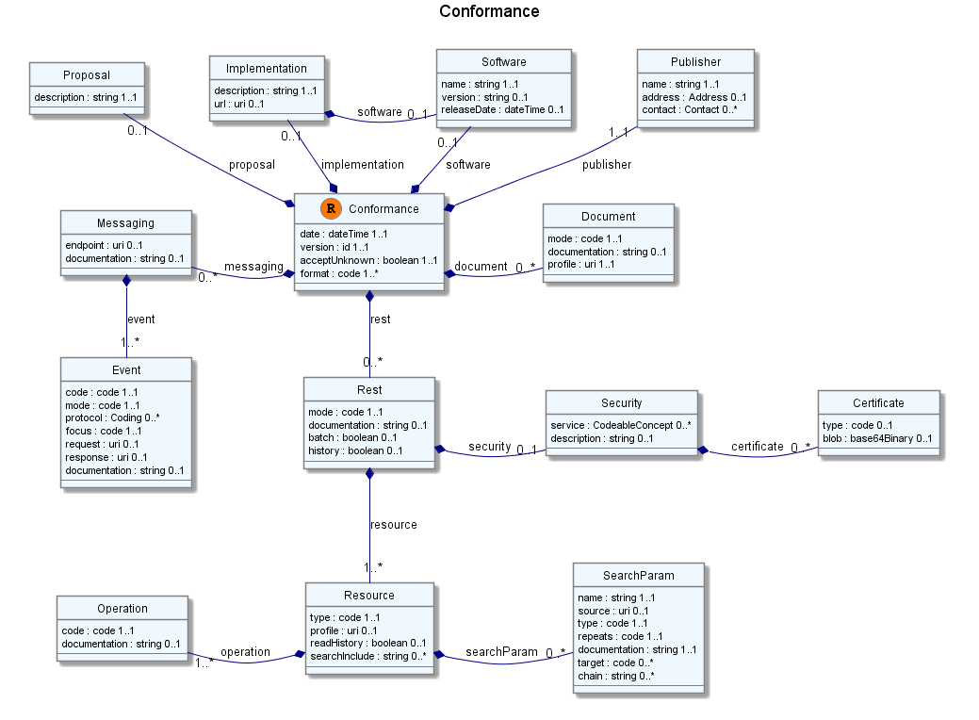
Conformance?

Slide 47
To create a resource
You POST the contents to an url which indicates the resource type:
E.g. http://server.org/fhir/patient
Supply body’s format in Content-Type header
Server returns body as stored (possibly altered!) with result 201 (Created)
Server returns newly assigned version id URL in the Location header.

Slide 48
To update a resource
Use PUT on the resource’s URL, with the new contents in the body
Tell server the body’s format (xml/json) in the Content-Type header
Server returns body as stored (possibly altered!)
Server returns URL to new version in the Content-Location header.

Slide 49
Using PUT to create
Server might/might not allow you to PUT to an id that does not yet exist.
If it does: Resource gets created at that location ➔ client determines resource’s id!
If it does not: server returns 405 (Method not allowed)
Notes:
- Whether server allows this depends on the level of trust between server and client: e.g. in-house scenario versus nation-wide network.

Slide 50
Version-aware updates
Server requires client to send Content-Location header with a version-specific URL
Server uses this to check whether you are updating the latest version.
Server will then return 409 (Conflict) if it has been updated by someone else in the meantime
Notes:
Behaviour depends on server configuration (and made public in a conformance statement).

Slide 51
Overview of PUT/POST ops
 | update | create
Path | resource url | /[resource type]
Request
Verb | PUT | POST
Content-Type | R | R
Body | Resource | Resource
Accept | O | O
Content-Location | O/R | N/A
Response
Content-Type | R | R
Body | Resource | Resource
Content-Location | R | O
Location | N/A | R
Last-Modified | R | O
Status | 400, 404, 405, 409, 412 | 201,400, 404
Notes:
- With batch you can send a whole bunch of update/create’s in one operation. This is transactional, so they either all get posted, or all refused. More on batches follows later in presentation, they deserve a separate topic.

Slide 52
Delete a resource
 | delete
Path | resource url
Request
Verb | DELETE
Content-Type | N/A
Body | N/A
Accept | N/A
Content-Location | N/A
Response
Content-Type | N/A
Body | N/A
Content-Location | N/A
Location | N/A
Last-Modified | N/A
Status | 204, 405, 404

Slide 53
What’s a ‘deleted’ Resource?
Trying read operations will return in a 410 (Gone) result in stead of 404 (Not Found)
The resource will not be returned by the search operation.
You can “undelete” by doing an update with fresh content
Just a “marker” in a resource’s history
Notes:
* the deletion operation should be understood as deleting the record of the resource, with nothing about the state of the real-world corresponding resource implied.

Slide 54
Version history - deletions
33, v12 – 2012-12-04
/server.org/fhir/patient/@33/history/@12
33, v13 – 2012-12-05
/server.org/fhir/patient/@33/history/@13
33, v14 – 2012-12-08
/server.org/fhir/patient/@33/history/@14
33, v15 – 2012-12-09
/server.org/fhir/patient/@33/history/@15
33, v16 – 2012-12-10
DELETION
/server.org/fhir/patient/@33/history/@16
/server.org/fhir/patient/@33
Notes:
* Now, if you query for /server.org/fhir/patient/@33, you get a 410

Slide 55
Version history - revival
33, v13 – 2012-12-05
/server.org/fhir/patient/@33/history/@13
33, v14 – 2012-12-08
/server.org/fhir/patient/@33/history/@14
33, v15 – 2012-12-09
/server.org/fhir/patient/@33/history/@15
33, v16 – 2012-12-10
/server.org/fhir/patient/@33/history/@16
33, v17 – 2012-12-11
/server.org/fhir/patient/@33/history/@17
/server.org/fhir/patient/@33
Notes:
* The resource returns back to life!

Slide 56
Question
DO I REALLY HAVE TO IMPLEMENT VERSIONS?
NO, You are not required to keep history, and may return 410 (Gone) on a “vread” for any request for an older version than the current one!

Slide 57
Intermezzo: BUNDLES
How FHIR uses Atom to communicate sets of resources
Notes:
Time: 0:50:00-1:30:00 (40 minutes)

Slide 58
Mapping (meta)data to HTTP
Resource data
Resource id
Resource version
Last update date
http body
Url
Content-Location header
Last-Modified header

Slide 59
Communicating lists
We need to communicate lists of Resources
Search result
History
Documents or messages
Multiple-resource inserts (“batches”)
So, we need an industry-standard to represent lists, and a place to put our metadata

Slide 60
Bundles
Atom RFC 4287 + Tombstones RFC 6721
Poll-based protocol for keeping up-to-date with newsfeeds (RSS and Atom)
You can “subscribe” to a FHIR feed and get updates
Notes:
- In our previous section on REST we saw how we mapped this metadata to HTTP headers, but in a query result, we need to find a way to map this to a list, Atom

Slide 61
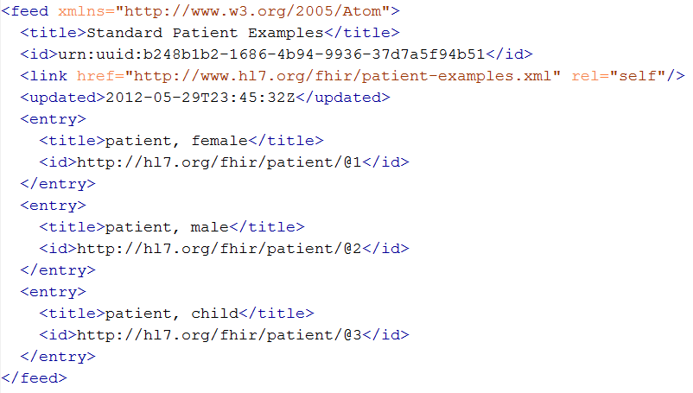
An example Bundle
1
2
2
2
Notes:
Note that the id of the resource is kept outside the resource itself
Atom has many other meta-data items (not shown), which we will discuss later.

Slide 62
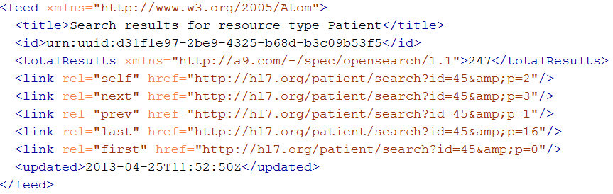
The feed header
Feed is simple:
“title” [1..1]: anything that tells humans what they’re looking at
“updated” [1..1]: the time (instant!) you composed the bundle
“id” [1..1]: a random, one-time id for this bundle
“link” [0..*]: page through the full results
“totalResults” [0..1]: number of total results
Notes:
Note that we use the ultra-new (sept 2012) Tombstones RFC, which is not yet supported by all platforms.
Remember, all updated timestamps in FHIR (type: ‘instant’) are precise to at least the second and ALLWAYS carry a timezone!

Slide 63
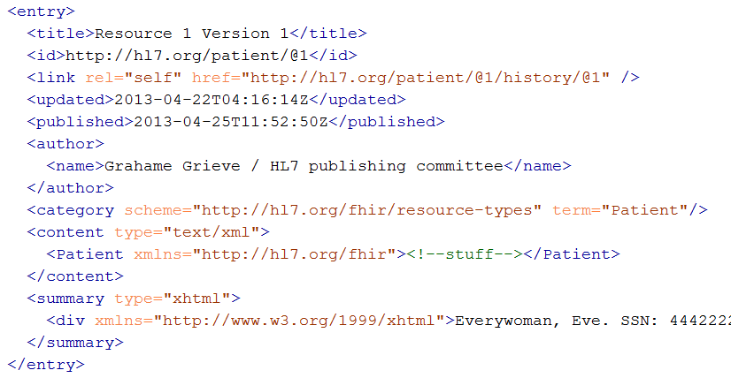
Resource entry
Resource id
Version-specific id
Last modified
Resource type
Resource content
Human-readable form,
just like Resource.text
Notes:
See how the resource meta-data is mapped to equivalent Atom members
Author is required by atom, so you’ll have to keep track who authored the resource, which might well be the user that POSTed it to your RESTful endpoint
Summary is optional, but it is easy to fill it with the Resource’s <text> (human readable narrative), so Feed readers have a way to display the contents of a resource. Yes, this means the summary is present twice in the entry.

Slide 64
Do a Search
http://server.org/patient/search? name=kramer&gender=M
Returns result in a bundle (Atom feed)
You can request (in Accept header):
‘true’ Atom (Xml): application/atom+xml
proprietary Json-Atom: application/json
Results can be paged using $page and $count
Notes:
All operations so far returned single resource, we use Bundles to return lists of resources
If you receive an empty bundle, there were no results.
Search is a very complex beast, which we will look at further at a later moment

Slide 65
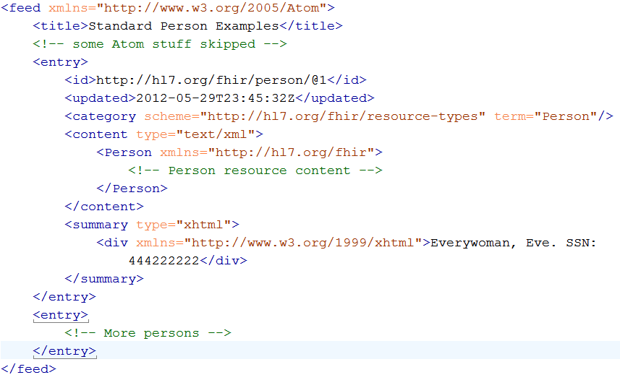
…what the result looks like
Here’s the resource’s id
Some more meta-data
1
The resource itself
Human-readable form,
just like Resource.text
2
Notes:
Note that the id of the resource is kept outside the resource itself
Atom has many other meta-data items (not shown), which we will discuss later.
This metadata was present in headers when fetching a single resource, but is put in the entry when fetching multiple. So actually two approaches….

Slide 66
Bundles
For both Java and C#, reference has custom-built Atom parser
For .NET, you could use the framework’s SyndicationFeed
A bit more low-level
No support for deleted-entries (even parse problems)
Incompatible with WinRT (Win8 mobile apps)
Notes:
* You might wonder: Since bundles are Atom, why not use standard Atom parsers?

Slide 67
Bundles in C#
Abstraction on top of Atom parser
Bundle = feed, BundleEntry = entry.
using HL7.Fhir.Instance.Support;
using HL7.Fhir.Instance.Serializers;
Bundle result = Bundle.LoadFromJson(new JsonTextReader(...));
result.Entries.Add(new ResourceEntry()
{ LastUpdated=DateTimeOffset.Now, Content = });
result.Entries.Add(new DeletedEntry()
{ Id = "http://...", When = then });
var bundleXml = result.ToXml();

Slide 68
REST service interface (continued)
How FHIR uses RESTful principles to communicate Resources
Notes:
Time: 0:50:00-1:30:00 (40 minutes)

Slide 69
Getting “all” patients
http://server.org/fhir/patient
Always returns a paged feed
Use _count to indicate number of results per page
Special “no criteria” case of the “search” operation
http://server.org/fhir/patient/search?name=Everyman

Slide 70
Keeping in sync
History of all resources on server
http://server.org/fhir/history
History of all patient resources on server
http://server.org/fhir/patient/history
History of specific patient on server
http://server.org/fhir/patient/@1/history
A history of all changes: updates and deletions, ordered by newest first
Limit with _since and _count

Slide 71
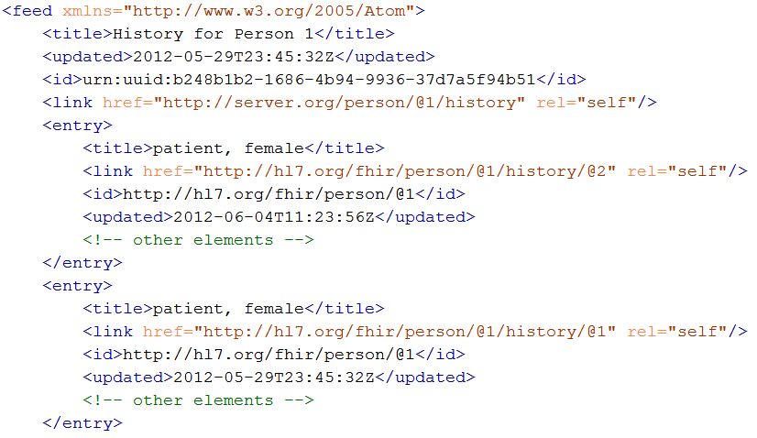
Multiple versions of entries
Same
id!
Notes:
Multiple versions are supported explicitly by Atom by having mutliple entries with the same id, but a different ‘updated’ date
Notice how the ‘self’ links do differ, these are different versions after all.

Slide 72
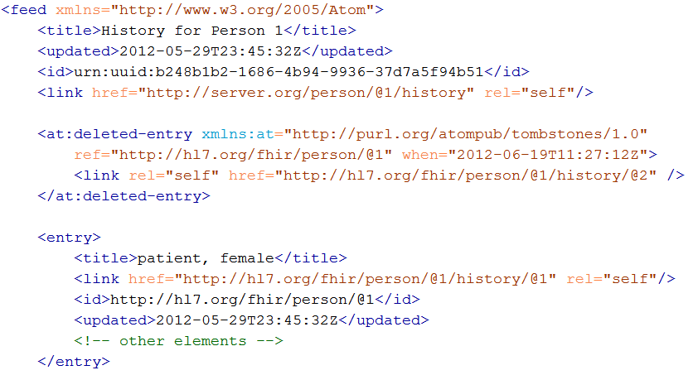
Atom Tombstones - Deletions
Notes:
Brand-new RFC, probably not much support in frameworks (yet).
Note the additional namespace
Updated Timestamp is still present, but is now called “when”.

Slide 73
Operations returning bundles
 | history | search
Path | /history [type]/history [resource url/history | /[type]/search /[type]
Request
Verb | GET | GET
Content-Type | N/A | N/A
Body | N/A | N/A
Accept | O | O
Content-Location | N/A | N/A
Response
Content-Type | R | R
Body | Bundle | Bundle
Content-Location | N/A | N/A
Location | N/A | N/A
Last-Modified | N/A | N/A
Status

Slide 74
The Binary endpoint
There’s a special /binary endpoint on which can store and retrieve binary data.
The endpoint operates mostly like a normal end point for resources (read, vread, updates, etc), but there is no search.
When you POST or PUT data specify the MIME type of the binary in the Content-Type header.

Slide 75
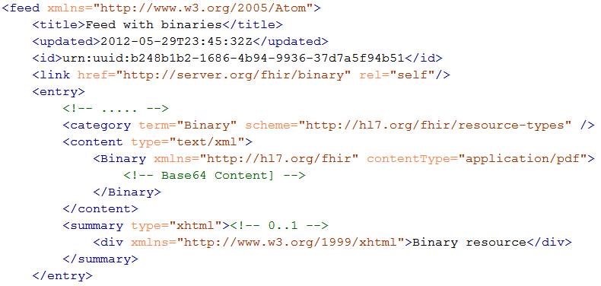
Binaries in Atom
Notes:
Looks just like a normal entry, but the resource type is “Binary”
Note: content’s type attribute is still “text/xml”
Even contents look like we’re dealing with a resource named Binary..
…but has an extra attribute “contentType”, which is the MIME type of the base64-ed content.

Slide 76
Support in C# and Java
var client = new FhirClient("http://fhir.com/svc/fhir");
Patient ewout = client.Read<Patient>("1");
ewout.Details.Name .Add(HumanName.ForFamily("Kramer") .WithGiven("Ewout"));
client.Update<Patient>(ewout, "1");

Slide 77
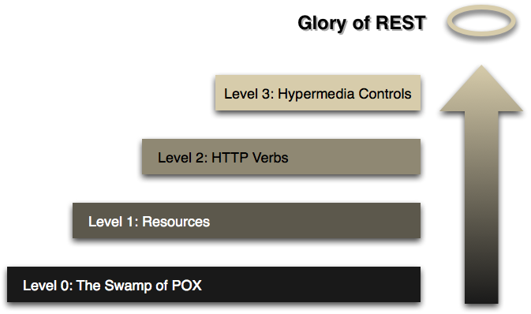
The Glory of REST
Source: http://martinfowler.com/articles/richardsonMaturityModel.html
Notes:
Richardson’s REST Maturity Model. We’re at 2.5. Fielding says: “You are not REST”, so we are “RESTful”

Slide 78
SEARCH FUNCTIONALITY
And finally, the last REST operation (for now):
Notes:
Time: 1:30:00-1:50:00 (20 minutes)

Slide 79
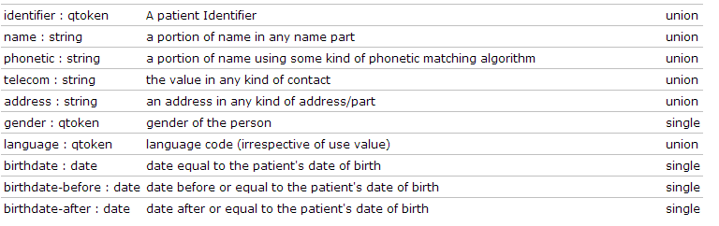
Search (patient)
Each resource has a set of “standard” search operations:
Parameter
Type
Repeat behaviour

Slide 80
Ingredients of search
Specifying multiple parameters finds resources matching all params ➔ “AND”
http://server.org/fhir/search?
birthdate=1972-11-30
&language=nl&language=fr
The same parameters may repeat:
union (“or”)
Intersection (“and”)
single (may appear only once)

Slide 81
Search example
In the Patient spec:
birthdate is a “date”, behaviour: “single”
language is a “qtoken”, behaviour: “union”
Searching query would look like: birthdate=1972-11-30 AND (language = ‘nl’ OR language=‘fr’)
If behaviour is “intersection”, repeating params would have been ANDed.

Slide 82
Ingredients of search
Date-based searches always come in triplets (exact, -before, -after)
http://server.org/fhir/search?
birthdate-after=1972-11-30
All parameters have a –missing:
http://server.org/fhir/search?
gender-missing=true

Slide 83
Types of parameters
integer | Search for an exact match on a whole number
string | Search for a partial match on a string
text | Searching on (longer) free text (may be sounds-like, conjugations, plural)
date | Search for an exact match on a date. Parameters look like 1956-05-27T12:34:12+04:00. Related searches for ‘before’ and ‘after’ always automatically included.
token | Searching for an exact match on a string
qtoken | Search parameter is a pair of fixed value strings, namespace and value, separated by a "#". The namespace is an uri, such as one of the defined code systems and is optional when searching. If specified namespace specified (system#value): find exact match on system + value If empty namespace (just #value): must have no namespace and exact match on value without namespace (just value), just search value.
Note: you need to escape the query-string!!
Notes:
private static Func<int, IntArgument, bool> intFilter = (i, sp) => i == sp.ValueAsInt();
private static Func<string, TokenArgument, bool> stringExactFilter = (s, sp) => s != null && s == sp.Value;
private static Func<string, StringArgument, bool> stringContainsFilter = (s, sp) => s != null && s.Contains(sp.Value);
private static Func<FhirString, TokenArgument, bool> fhirTokenFilter = (fs, sp) => fs != null && stringExactFilter(fs.Contents, sp); //TODO: Account for StringArgument.Position
private static Func<FhirString, StringArgument, bool> fhirStringContainsFilter = (fs, sp) => fs != null && stringContainsFilter(fs.Contents, sp);
private static Func<List<FhirString>, StringArgument, bool> fhirStringListContainsFilter = (fsl, sp) => fsl != null && fsl.Any(fs => fhirStringContainsFilter(fs, sp));
private static Func<FhirUri, StringArgument, bool> fhirUriExactFilter = (fu, sp) => fu != null && fu.Contents.ToString().ToLower() == sp.Value.ToLower();
private static Func<FhirString, FhirUri, QTokenArgument, bool> fhirQTokenFilter = (fs, fu, arg) => fhirTokenFilter(fs, arg.Token) && (arg.Namespace == null ? true : fhirUriExactFilter(fu, arg.Namespace));
private static Func<Code, TokenArgument, bool> codeExactFilter = (c, sp) => c != null && stringExactFilter(c.Contents, sp);
private static Func<Code, StringArgument, bool> codeContainsFilter = (c, sp) => c != null && stringContainsFilter(c.Contents, sp);
private static Func<Coding, QTokenArgument, bool> codingExactFilter = (c, sp) => c != null && codeExactFilter(c.Code, sp.Token) && (sp.Namespace == null ? true : fhirUriExactFilter(c.System, sp.Namespace));
private static Func<Coding, StringArgument, bool> codingContainsFilter = (c, sp) => c != null && codeContainsFilter(c.Code, sp);
private static Func<CodeableConcept, QTokenArgument, bool> coCoExactFilter = (cc, sp) => cc != null && fhirTokenFilter(cc.Text, sp.Token) || cc.Coding.Any(c => codingExactFilter(c, sp));
private static Func<CodeableConcept, StringArgument, bool> coCoContainsFilter = (cc, sp) => cc != null && fhirStringContainsFilter(cc.Text, sp) || cc.Coding.Any(c => codingContainsFilter(c, sp));
private static Func<Identifier, QTokenArgument, bool> identifierFilter = (i, sp) => i != null && fhirQTokenFilter(i.Id, i.System, sp);
private static Func<HumanId, QTokenArgument, bool> humanIdFilter = (hi, sp) => hi != null && identifierFilter(hi.Identifier, sp); //CK: Also Argument on the period?
private static Func<List<HumanId>, QTokenArgument, bool> humanIdListFilter = (hil, sp) => hil != null && hil.Any(hi => humanIdFilter(hi, sp));
private static Func<HumanName, StringArgument, bool> humanNameFilter = (hn, sp) => hn != null && (
fhirStringContainsFilter(hn.Text, sp) ||
fhirStringListContainsFilter(hn.Family, sp) ||
fhirStringListContainsFilter(hn.Given, sp) ||
fhirStringListContainsFilter(hn.Prefix, sp) ||
fhirStringListContainsFilter(hn.Suffix, sp)
);
private static Func<List<HumanName>, StringArgument, bool> humanNameListFilter = (hnl, sp) => hnl != null && hnl.Any(hn => humanNameFilter(hn, sp));
private static Func<Contact, StringArgument, bool> contactFilter = (c, sp) => c != null && fhirStringContainsFilter(c.Value, sp);
//&&
//(sp.Namespace == null) ? true :
//c.System != null && c.System.Contents != null &&
//c.System.Contents == (Contact.ContactSystem)Enum.Parse(typeof(Contact.ContactSystem), sp.Namespace.Value, true); //TODO: Niet zo mooi. Hebben we een Code<Contact.ContactSystem> - filter nodig?
private static Func<List<Contact>, StringArgument, bool> contactListFilter = (cl, sp) => cl != null && cl.Any(c => contactFilter(c, sp));
private static Func<Address, StringArgument, bool> addressFilter = (a, sp) => a != null && (
fhirStringContainsFilter(a.Text, sp) ||
fhirStringListContainsFilter(a.Part, sp) ||
fhirStringListContainsFilter(a.Line, sp) ||
fhirStringContainsFilter(a.City, sp) ||
fhirStringContainsFilter(a.State, sp) ||
fhirStringContainsFilter(a.Zip, sp) ||
fhirStringContainsFilter(a.Country, sp) ||
fhirStringContainsFilter(a.Dpid, sp)
);
private static Func<List<Address>, StringArgument, bool> addressListFilter = (al, sp) => al != null && al.Any(a => addressFilter(a, sp));
private static Func<FhirDateTime, DateArgument, bool> fhirDateTimeFilter = (fd, sp) =>
{
bool result = false;
if (fd != null)
{
FhirDateTime reference;
if (FhirDateTime.TryParse(sp.Value, out reference))
switch (sp.Position)
{
case DateArgument.DatePosition.Before:
throw new ArgumentException("FhirDateTime does not support the <= operator, so DateArgument.DatePosition.Before is not supported.", "DateArgument.Position");
case DateArgument.DatePosition.After:
throw new ArgumentException("FhirDateTime does not support the >= operator, so DateArgument.DatePosition.After is not supported.", "DateArgument.Position");
case DateArgument.DatePosition.On:
result = fd == reference;
break;
}
}
return result;
};
private static Func<ResourceReference, ReferenceArgument, bool> resourceReferenceFilter = (rr, sp) =>
{
bool result = false;
if (rr != null && rr.Id != null && rr.Id.Contents != null)
{
//TODO: Find out how the FhirUri rr.Id is structured. Full URL, just an id, with/without version? Then match it on some value from the managed resources in the collection
//For now we assume that the id is the last (or only) element of the FhirUri.
result = rr.Id.Contents.ToString().In(sp.ReferencedCollection);
}
return result;
};
#endregion Building blocks for predicates

Slide 84
Search: Type x Datatype
How to actually find a match is determined by the the type of Resource attribute that you search on, for example: Patient.name is a “string” (see search parameter) on a HumanName
Search for any partial match on name.Text & name.Family & name.Given

Slide 85
Search: Type x Datatype
…and sometimes also dependent on the type of parameter used:
Searching with a qtoken on a Coding
Exact match on Coding.code & Coding.system
Searching with a string on a Coding
Partial match on Coding.code
Notes:
This is however, one of the big TODO’s in the spec, and not yet fully documented

Slide 86
Chained searches
Patient has a search for “name”.
Observation has a search for “subject” (the id of the Patient, Group or Device)
How do I find Observations for a patient, searching using his name?

Slide 87
2 queries in 1
You (as a client) don’t need to do separate operations, just one:
http://server.com/fhir/observation/search?
subject.name=peter
But note: this still only works on the predefined search parameters. You cannot just use any property of the resource.

Slide 88
As yet undefined
Observation has a search for “subject” (the id of the Patient, Group or Device)
So, what do you do when you search for:
subject.name (Group.name != Patient.name)
Subject.gender (Groups and Devices wont match)

Slide 89
Beyond REST
How FHIR supports messages and documents
Notes:
Time: 1:50:00-2:00:00 (10 minutes)

Slide 90
Documents – are bundles
<feed>
<entry>
<Document />
</entry>
<entry>
<Observation />
</entry>
<entry>
<Device />
</entry>
<entry>
<Prescription />
</entry>
<entry>
<Patient />
</entry>
</feed>
Document Resource
Section
Metadata
Attester
Section
Observation Resource
Device Resource
Prescription Resource
Patient Resource
Notes:
A Document, no matter how nested, is flattened to a list of entries, the Document’s header being the first.
The document header (and any other the other resources) refer to each other using normal references to reflect the document’s nesting.
Of course, there may be a digital signature (on the whole Bundle) to attest to the content of the document.

Slide 91
Communicating documents
No REST involved: transport as a SOAP or MLLP payload, e-mail, …
You can still store & retrieve your document using a FHIR REST server (like any artifact):
http://server.org/fhir/binary
Here, your document is treated as a “blob”, so the document remains a unit, posting a document does not suggest disassembly!
Notes:
* But ofcourse, some server could have functions to disassemble documents on reception. Since the contents of documents are resources, each of the contained resources (including the Document header) can be stored using the normal REST interface. But they are no longer the document anymore!

Slide 92
Communicating documents
You can also “drop” your document using FHIR on
http://server.org/fhir/mailbox
No storage or disassembly is implied, your just posting a document in its entirety.
Servers can implement specific functionality as required between trading partners when receiving such a document.
Notes:
* But ofcourse, some server could have functions to disassemble documents on reception. Since the contents of documents are resources, each of the contained resources (including the Document header) can be stored using the normal REST interface. But they are no longer the document anymore!

Slide 93
Messages – are bundles
<feed>
<entry>
<Message />
</entry>
<entry>
<Observation />
</entry>
<entry>
<Patient />
</entry>
<entry>
<Device />
</entry>
</feed>
Message Resource
source
destination
event
Observation Resource
Device Resource
Patient Resource
Notes:
A Message is similar, refers (amongst others) to its author, and contains information about the source, destination and the event that triggered it.
A message contains 1 “data” resource, which is the root of the payload of the message. This is just a normal resource, which in its turn can refer to other related resources.

Slide 94
Sending messages
Again, REST not necessary, but…
There is an explicit REST endpoint:
http://server.org/fhir/mailbox
No storage implied. Might be a router, converted to v2, etc. etc.
The server can process them based on the event code and return the response as another message (again a bundle).
Notes:
* It’s the same drop-off point as for documents!

Slide 95
FHIR on the wire
How FHIR utilizes Xml, JSON and Atom
Notes:
Time: 2:00:00-2:25:00 (25 minutes).

Slide 96
Briefest intro to JSON
JSON (“JavaScript Object Notation”): it’s JavaScript, not markup!
{ “Country" : { “name" : “the Netherlands", “population" : 16696000,
“popDensity” : 447.9
}
}
var report = eval(“({…})”); alert(report.LabReport.status);
Very easy parsing for JavaScript clients. But actually, use JSON.parse() instead ;-)

Slide 97
Xml and JSON are different
Xml
JSON
<XXX xmlns=“urn:foo”>
<B a=“c” />
<C>One</C>
<C>Two</C>
<D>One</D>
<div>Not <b>so</b> easy</div>
</XXX>
{ “B”: { “@a” : “c” },
“C”: [ “One”, “Two” ],
“D” : “One”,
“div” : {
“#text”:“Not”, “b”:“so”,
“#text”:“easy” }
}
How to retain namespaces?
How do you identify attributes?
Bridge difference in datatypes?
Distinguish single elements from lists with one element?
Mixed content?
Notes:
We tried to find a way to automatically convert between the two so you could round-trip…
But discovered you’d need additional metadata to do that, or vendor-specific solutions
Decided not to introduce these: result was weird Xml or weird Json
Reference platform contains tools to interconvert (these use model definition metadata)

Slide 98
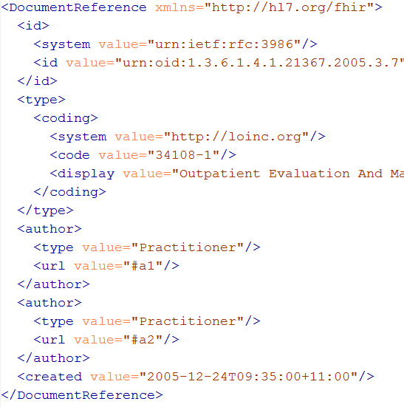
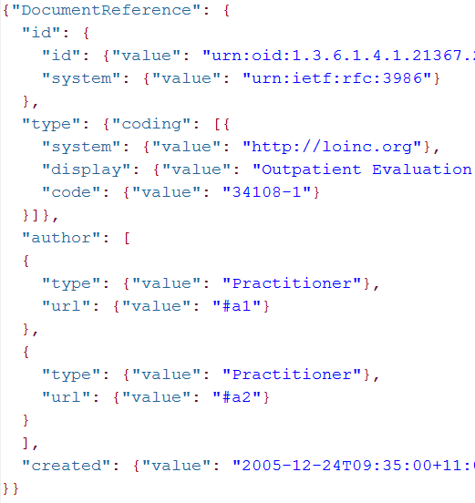
Xml and Json match
code.coding is 0..*
primitives

Slide 99
Atom in JSON
There’s not yet a way to render Atom in JSON, though there are initiatives, all ugly.
So, we had to (sorry) roll our own….
…very straightforward, single-purpose
Atom JSON solution
(Note: MIME type is still application/json!)

Slide 100
Json Atom - Example
{
"title": "Search result",
"updated": "2012-09-20T12:04:45Z",
"id": "urn:uuid:50ea3e5e-b6a7-4f55-956c-caef491bbc08",
"link": [ { "rel": "self", "href": "http://server.org/fhir/patient?format=json" } ],
"entry": [
{ "title": "Resource of type Patient, with id = 1 and version = 1",
"link": [ { "rel": "self", "href": "http://fhir.furore.com/fhir/patient/@1/history/@1" } ],
"id": "http://fhir.furore.com/fhir/patient/@1",
"updated": "2012-05-29T23:45:32Z",
"published": "2012-09-20T12:04:47Z",
"author": [ { "name": "Grahame Grieve / HL7 publishing committee" } ],
"category": [ { "term": "Patient", "scheme": "http://hl7.org/fhir/resource-types" } ], "content":
{ "Patient": { } }
}
]
}
Notes:
Just take a quick glimpse, it’s a pretty trivial translation of the Xml form to JSON, removing all needs for namespaces and attributes, and turning repeating elements into JSON arrays.

Slide 101
INSIDE THE FHIR DISTRIBUTION
Notes:
Time: 2:25:00-2:35:00 (10 minutes)

Slide 102
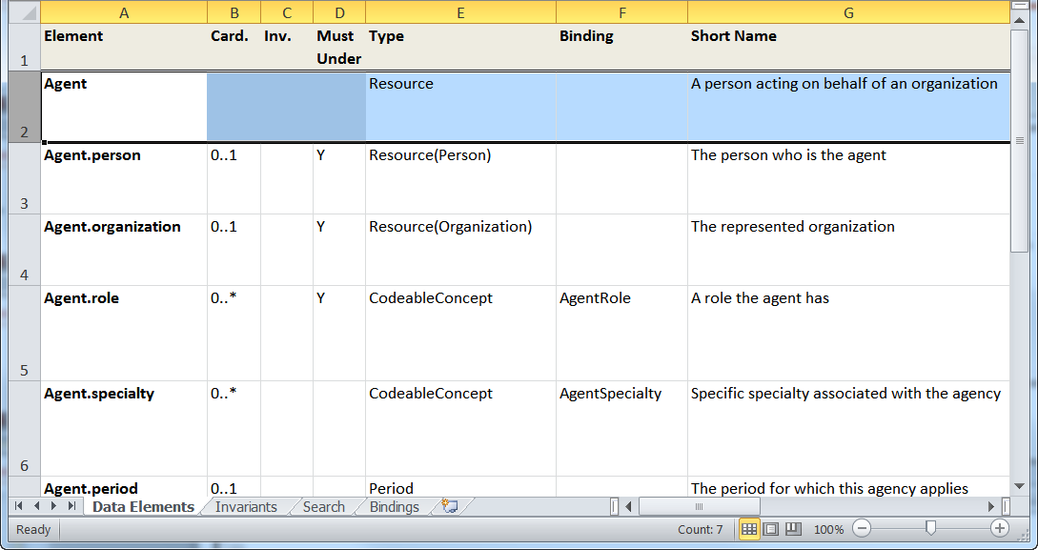
“Source” of FHIR

Slide 103


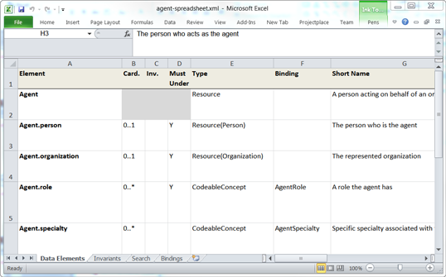


Publication process
.INI
Publication tool
(org.hl7.fhir.tools.jar)
Website
Examples
Resource
UML
Java, C#,
Delphi
Validation
Schema’s
DictXml
Resource profiles
eCoreDefinitions.xml

Slide 104
On the FHIR website
Under “Implementation”…
A zip with all schema’s + schematron to validate Xml messages
A zip with all examples (in both xml and json format).
Delphi.zip, Java.zip, CSharp.zip
The whole website (multiple html files) or book (=1 BIG html file)
Notes:
If you come to a connectathon with a FHIR server, it is a good idea to make sure you can preload your server with all the examples!

Slide 105
In the FHIR SVN
http://gforge.hl7.org/svn/fhir/trunk
All presentations (/presentations)
All Resource source files (Excel) (/source)
Source of the publication process (/tools)
Archived older versions of FHIR (/archive)
Help extend generation, use eCoreDefinitions (/publish)
We use Eclipse + Java 1.6

Slide 106
Building a fhir server
FHIR in practice
Notes:
Time: 2:35:00-2:55:00 (20 minutes)

Slide 107
Overview of a server
HTTP / REST interface
Encoding/decoding, param validation, syntax validation
Implement service operations as described in spec
Fhir Service
Indexer / Search
Storage

Slide 108
From wire to store
REST interface
JSON/XML
JSON/XML
JSON/XML
JSON/XML
FHIR Parser
FHIR Parser
FHIR Parser
FHIR Parser
Fhir Service
POCO/POJO
POCO/POJO
JSON/XML
POCO/POJO
O-R Map
Serialize
Serialize
Storage
NoSql (Xml/Json)
NoSql (Xml/Json)
DBMS
DBMS
Notes:
First scenario is most common for existing databases: you have to map the FHIR structure (as POCO’s) onto your (existing) databases tables. Lot’s of mappings to support our nesting, cardinalities, datatypes
Second scenario uses the parsers to create POCO’s then use a NoSql driver’s serialization possibilities to store the structure-as-is in NoSql
Third scenario avoids creating POCO’s at all, and uses either xml or json natively for processing and storage
Fourth scenario uses POCO’s and DBMS, but instead of mapping FHIR to tables, stores the data as-is into blob storage in a DBMS

Slide 109
Document-oriented store
A document-oriented store can store Resources as a “whole” document.
E.g. MongoDb stores documents in JSON:
post = { author: “mike”,
text: “my blog post...”,
tags: [“mongodb”,“intro”] };
db.posts.save( post );
db.posts.find( { author: “mike” } );
db.posts.find().sort({date: -1}).limit(10);
Notes:
* Demo with MongoVue

Slide 110
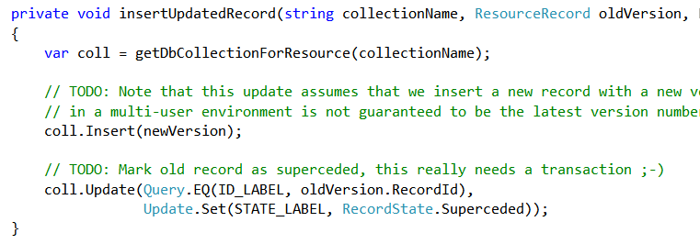

No (sql) transactions

Slide 111
Storing resources
FHIR POCO Model
Mongo
Patient
Atom Entry
(stored json)
Resource
Binary
Observation
Amazon S3
Metadata
Binary
Original
(json or xml)
Notes:
You might have to keep the original (as you received it on the service interface), for attestation/digital signatures
Store the binaries in another location (e.g. Amazon S3, filesystem) and just keep the URL here.

Slide 112
RDBMS: BLOB + Index
Id | ResourceId | VersionId | LastUpdate | Contents
1 | 1 | 1 | 2012-12-19 | <Patient …>
2 | 1 | 2 | 2012-12-20 | <Patient …>
3 | 2 | 1 | 2012-12-20 | <Observation …>
Id | Param | Value | System
2 | Patient.Name | “Ewout”
2 | Patient.DoB | “1972-11-30”
3 | Obs.Code | “234332” | SNOMED
Separate tables for current and history?
Type | VersionIdHigh
Patient | 2
Lab | 3
Need to index only latest version!

Slide 113
2 queries in 1 (review)
You (as a client) don’t need to do separate operations, just one:
http://server.com/fhir/observation/search?
subject.name=peter
But note: this still only works on the predefined search parameters. You cannot just use any property of the resource.

Slide 114
“Joining” documents
Patient Collection
Observation Collection
Patient @1, version @1
Obs @8, version @5
Patient @1, version @2
Obs @8, version @6
Patient @2, version @1
Obs @9, version @1
Patient Indices
Observation Indices
<[name]> <type><!-- 0..1 code Resource Type --></type> <url><!-- 0..1 uri URL/Id of the reference --></url>
<display><!-- 0..1 string Text alternative -></display>
</[name]>
Notes:
Different resource types are stored in different collections, along with indices on the searchable properties
Note that although logically for example Observation refers to Patient, NoSql databases like MongoDb have no concept of joins or foreign keys.
So, to fetch all Observations of a Patient, you query all documents in the Observation collection for which the Observation.subject property matches the Patient’s id.
Because references can point to multiple types of Resources (Observation.subject can be Animals and Devices too), and a reference can contain version-specific id’s, “joining” is not a trivial operation!

Slide 115
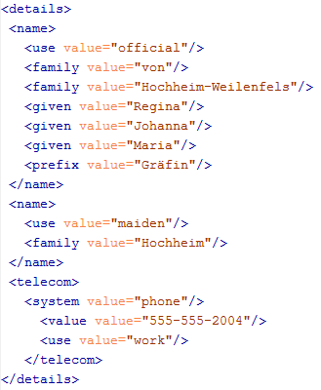
Why a separate index?
patient/search? name=johan& name=grafin& telecom=5552004
“Groom” – prepare for searching

Slide 116
Search (in C#)
The, on top of these primitive clauses, we define LINQ clauses for the structured types:
humanNameFilter = (hnl, param) // <HumanName, StringArg>
=> stringContainsFilter(hn.Text, param) ||
stringListContainsFilter(hn.Family, param) ||
stringListContainsFilter(hn.Given, param) ||
stringListContainsFilter(hn.Prefix, param) ||
stringListContainsFilter(hn.Suffix, param);

Slide 117
Search (in C#)
Many datatypes, primitives and arrays of types have specific search criteria:
stringListContainsFilter = (fsl, sp) <List<String>, StringArg> => fsl.Any(fs => fhirStringContainsFilter(fs, sp.Value));
stringContainsFilter = (value, arg) // <String, StringArg>
=> value.ToLower().Contains(arg.Value.ToLower());
codeFilter = (code, arg) // <Code, QTokenArg>
=> code.Code == arg.Code && (arg.System == null ? true || code.System == arg.System );

Slide 118
Search (in C#)
Then, when a search request comes in, we construct the final query, based on the actual parameters:
Patients.Where( pers=> codeFilter( pers.Gender, args[“gender”] ) && humanNameFilter( pers.Name, args[“name”] );
Then fire the LINQ query to Mongo (becomes mongo query) or SqlServer (gets turned into SQL)

Slide 119
Validation
When receiving an XML resource
1. Validate using schema
2. Run schematrons
When receiving JSON
1. Parse the JSON
2. Serialize to XML
3. Validate using schema
4. Run schematrons

Slide 120
More support & latest
www.hl7.org/fhir
fhir@lists.hl7.org
#FHIR
Implementor’s Skype Channel!
RIMBAA meetings (this WGM)
http://fhir.furore.com and
http://hl7connect.healthintersections .com.au/svc/fhir/

Slide 121
QUESTIONS?
Notes:
Time: 10:00-35:00 (25 minutes)

